Slide 1
Inpatient COI
Mealtime Insulin & Coordination of Inpatient Diabetes Care survey
March 2020

Slide 2
Purpose & Methods
The purpose of the Inpatient Management COI survey was :
Understand current practices related to mealtime insulin and coordination of diabetes care around meals
Efficiently capture feedback (time spent to complete survey: <4 minutes)
Methods:
Survey conducted March 4-13, 2020
86 participants
621 subscribers to this COI

Slide 3
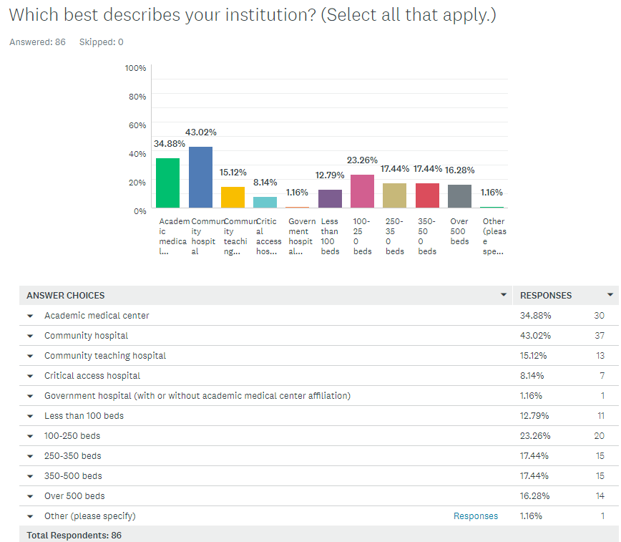
Survey Results
Question 1:
Which best describes your institution? (Choose all that apply.)
Comment: Urban non-profit hospital

Slide 4
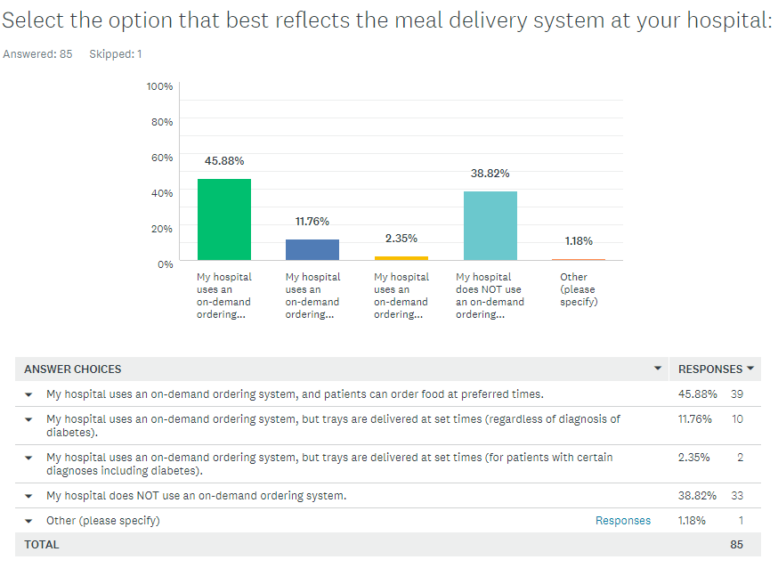
Survey Results
Question 2:
Which best describes your institution? (Choose all that apply.)
Comment: Host from Nutrition Services announce to whole unit staff that tray will be arriving so nurses can do FSBG and insulin admin

Slide 5
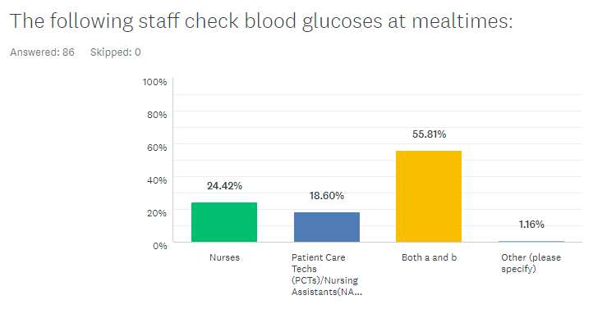
Survey Results
Question 3:
Select the option that best reflects the meal delivery system at your hospital.
Comment: a and b, however, only ICU, ED RNs do and med-surg floor RNs do not

Slide 6
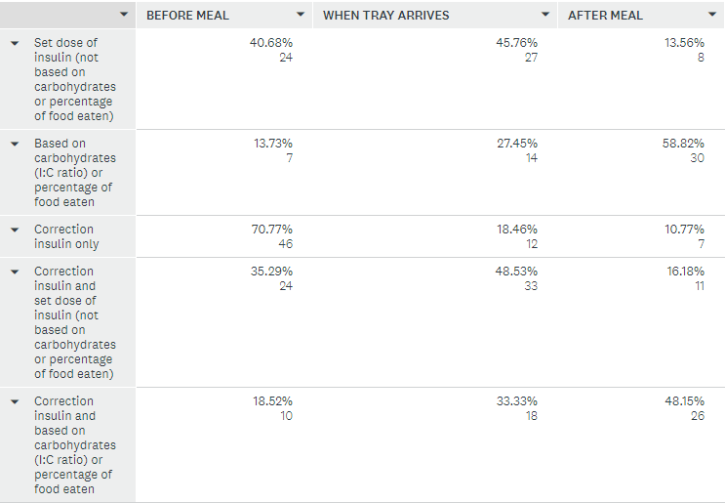
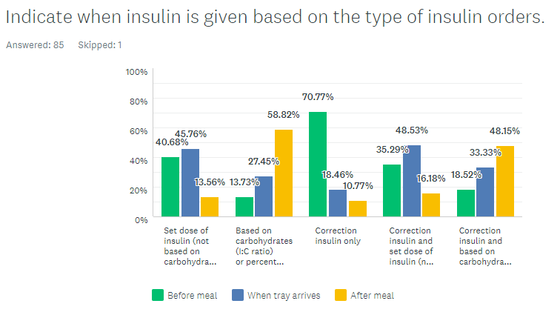
Survey Results
Question 4:
Indicate when insulin is given based on type of insulin orders.

Slide 7
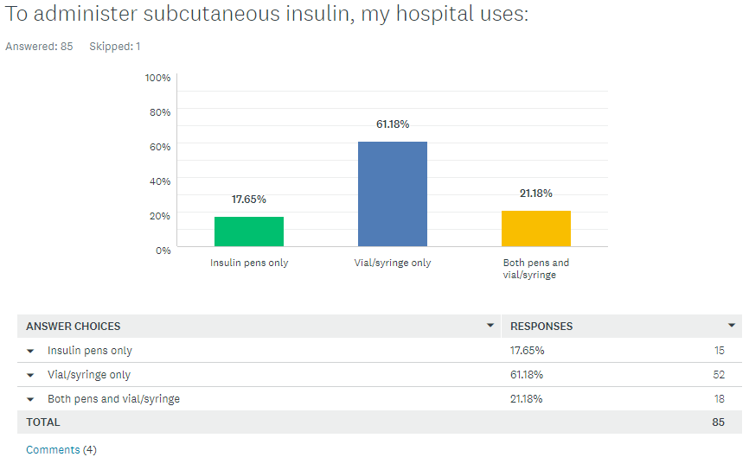
Survey Results
Question 5:
To administer subcutaneous insulin, my hospital uses…
Comments:
U-500 pens with safety needles recently introduced, but all other insulin has always been vial & syringe
newly dx peds we get pens ordered for them
pen only for U500 or teaching purposes, vial/syringe typically
Insulin pump if patient is wearing while in the hospital

Slide 8
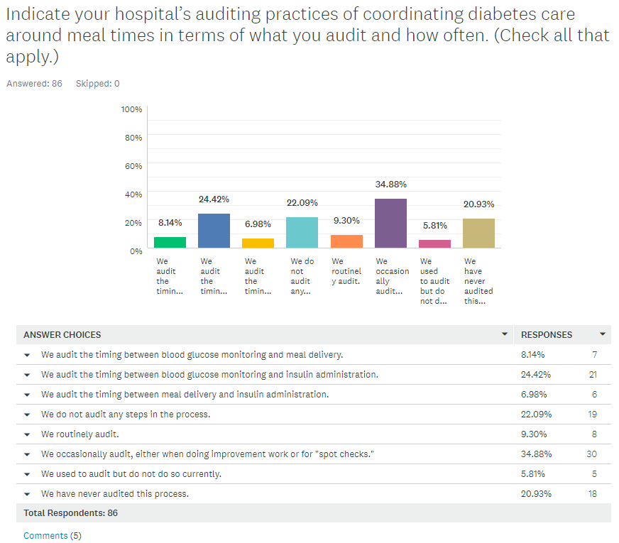
Survey Results
Question 6:
Indicate your hospital’s auditing practices of coordinating diabetes care around meal times in terms of what you audit and how often.
Comments:
We are in the process of setting up a report that captures time tray ordered, time pre-meal BG is checked, time meal is delivered and time pre-meal insulin is dosed.
We used to track meal delivery times, but that did not accurately reflect when patients were actually "eating"
we are trying to create reports to audit timing between BG & insulin delivery
depends on the floor or level of care
Daily reports for any hypos <54 with root cause analysis

Slide 9
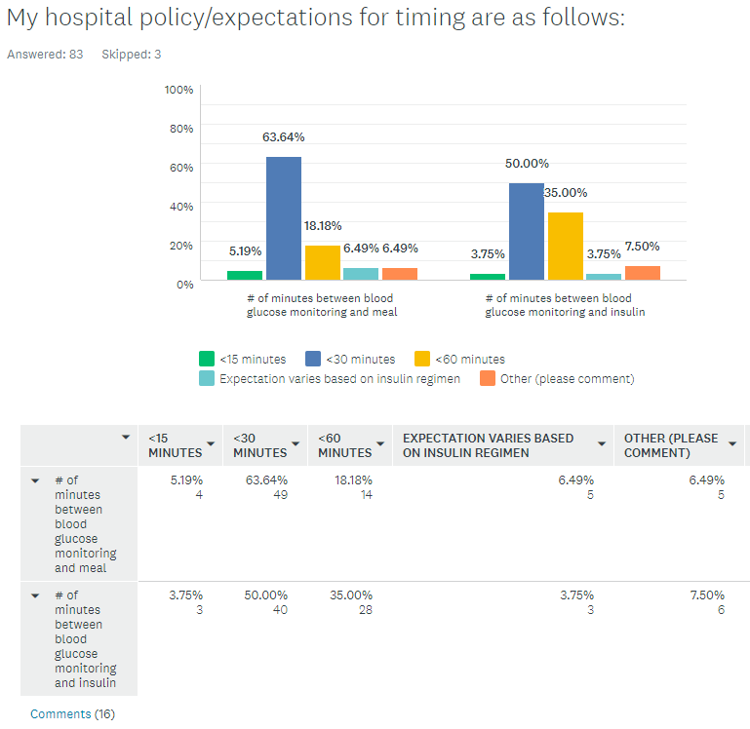
Survey Results
Question 7:
My hospital policy/expectations for timing are as follows:
Comments: See next slide

Slide 10
Survey Results
Comments:
Insulin timed with meals to allow for before, with or within 1 hr BG-poc.
At the time the tray is delivered/when tray arrives glucose is checked and insulin is administered
Our hospital is on sliding scale insulin as it is too hard for insulin top carb ratio education for staff and population of patients per the powers that be. Its just so sad. No one in authority here listens to diabetes CDCES experts.
Very poor job. Sliding scale dose based on random glucose values only
We teach that if 60+ minutes have elapsed between BG check and meal delivery/insulin dosing, the BG must be rechecked
75 minutes
Immediately after completion of meal
<45 minutes
But this is not happening
30-<45 minutes
Our hospital expectation is at least ½ hour before a meal but there is a variation of practice on some units. At times the POC is being done 1-2 hours before the meal arrives and the RN administering the correction scale if needed.
No determined time frame, 8a – 12n- 5p are times on EMAR
60 minutes is getting CHO coverage and correction at same time.
There is no policy and meal time insulin is delivered whenever it is in the window for nursing to deliver it. Most mealtime insulin is sliding scale, unless requested by myself for a set dose plus sliding scale. Most of our patients are not on carb ratios and when they are, I practically have to “baby” the situation to make sure that insulin and meal delivery is within an appropriate time frame. And then I educate and educate and educate more about how the insulin should be delivered.
45 mins
<30 min with set doses; <60 min with I:C rations
Question 7:
My hospital policy/expectations for timing are as follows:

Slide 11
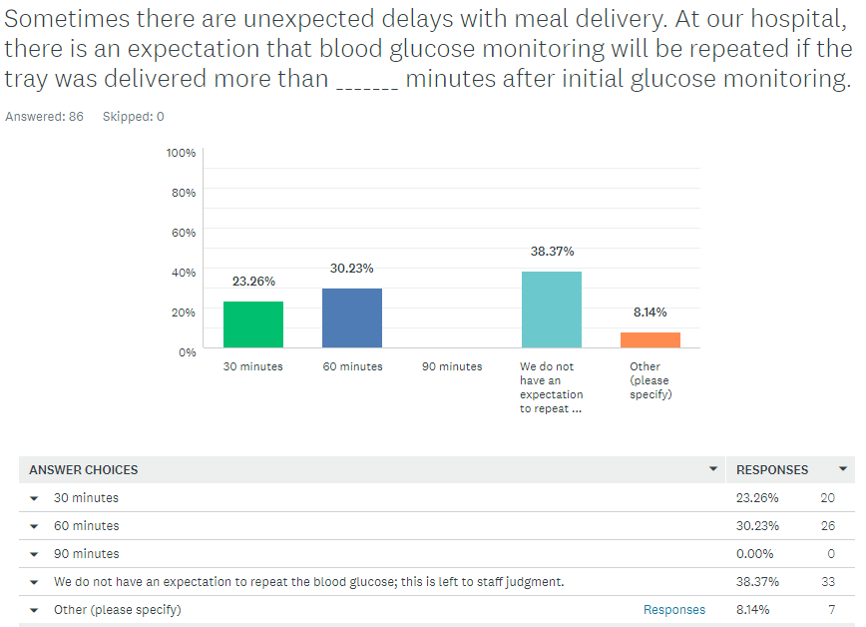
Survey Results
Question 8:
Sometimes there are unexpected delays with meal delivery. At our hospital, there is an expectation that blood glucose monitoring will be repeated if the tray was delivered more than _______ minutes after initial glucose monitoring.
Comments:
Insulin only adminstered after tray is in room
PWD Trays are delivered to the nurses desk not the PWD rooms
repeat is recommended but not in policy
They would only recheck after 30 minutes if a correction dose was involved
45 minutes
the person who delivers the tray voceras the person who is doing the blood glucose test ( the PCT0 and the nurse responsible for the patient when they are leaving the kitchen THe PCt then does the test and notifies the nurse of result so that she can administer the insulin
We do not do accu check if tray is not present to avoid the meal delay issue

Slide 12
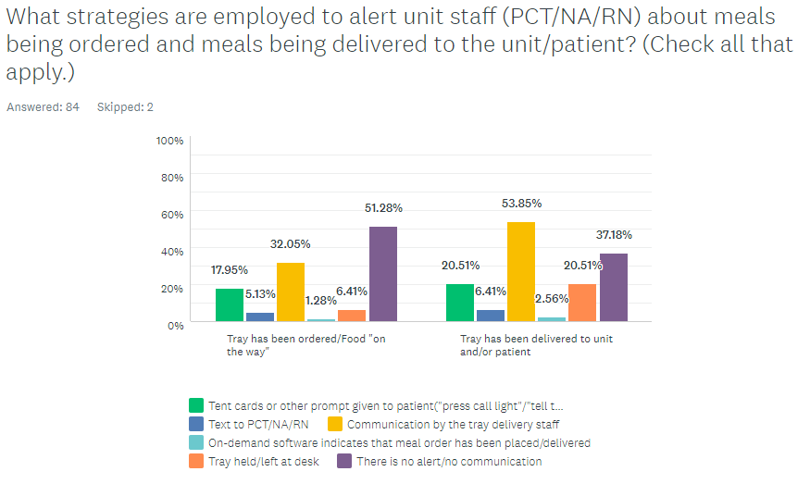
Survey Results
Question 9:
What strategies are employed to alert unit staff (PCT/NA/RN) about meals being ordered and meals being delivered to the unit/patient?
Comments: See next slide

Slide 13
Survey Results
Comments:
Each floor is aware of their standard delivery times.
It is mandatory that a nurse or unit coordinator signs for the tray- and the nurse is responsible for taking the tray in room and giving insulin injection
Texts are sent to pilot unit staff only (at present). A variety of different strategies (tent cards, call light, leaving at desk, etc.) have all been implemented on different units, but no consistent (and enduring) practice.
To secretary then to RN via vocera
We had an on demand system with alerts built through the process, but this is not happening.
Unit secretary announces overhead when trays are on the unit.
Our CNAs only check BGs if tray has been ordered
We have set meal times
Tray held only for precaution patients
We are in the process of implementing a text to the PCT or nurse when tray is ordered and another alert when the tray is delivered
There is an inconsistency on each unit.
A few units announce that trays are on the unit, prepare patients
Dietary Hostesses call unit when they are leaving the kitchen with the trays, we do not have “on demand”
Question 9:
What strategies are employed to alert unit staff (PCT/NA/RN) about meals being ordered and meals being delivered to the unit/patient?

Slide 14
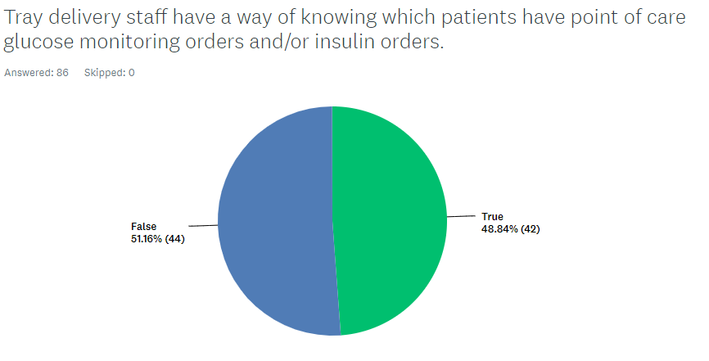
Survey Results
Question 10:
True or False:
Tray delivery staff have a way of knowing which patients have point of care glucose monitoring orders and/or insulin orders
Comments: See next slide

Slide 15
Survey Results
Comments:
Each floor is aware of their standard delivery times.
Tray ticket marked
Apple sign on whiteboard
There is a sticker on the tray to alert the staff the tray is for a patient with diabetes and a signature is needed before leaving the tray
All PDW trays on insulin regime go to the Ward/ RNDesk
CBORD and Epic “talk” to one another, so Call Center staff can see the pre-meal insulin order (pre-meal lispro only; not pre-meal Regular, 70/30, pumps or U-500)
There is a Yellow sticker placed on the tray by the person preparing the tray. It reads “Has your blood sugar been tested? If not, turn on your Nurse Call Light and DO NOT EAT.”
Our dietary dept gets a report of who has insulin ordered, a note gets put on tray, for staff and patient to call nurse prior to eating
pt or unit staff tell the tray delivery staff
Tent card on the tray
The tray ticket prints “Check clipboard” so that they check at the desk to ensure the BG has been checked prior to delivering
“insulin” noted on ticket on tray
Type of meal plan patient is on
Based on patient with CCD ordered.
Tray staff are only aware that carb consistent meal trays are delivered to the unit station.
Card on tray lets the delivery staff know to call the nurse/tech to check BG and “insulin” is typed out on the meal ticket as well
Door signage
We recently developed a report that states if a pt receives insulin. This report is printed in diet office and the tray then gets special color tray mat
Always ask before delivering tray to any patient
The tray tickets are stamped “insulin”. Insulin trays are delivered in a separate cart from “non insulin” trays.
They run a list of all patients on hypoglycemic meds and use this to notify nurse
Magnet at door; tent card on tray; meal ticket
Meal ticket is stamped in food/nutrition with the word insulin
Carb restricted meals have a blue place mat on tray.
Indicated on tray
Stop card on tray that is initiated by electronic order set
They have a carb count ticket – trays are left at desk for nurses to do accu check before meals. Trays are routinely audited for on time delivery
We did some custom build in our on-demand system so that there’s an marker for those patients with POC glucose orders. This really has helped to trigger extra communications by tray delivery staff.
Question 10:
True or False:
Tray delivery staff have a way of knowing which patients have point of care glucose monitoring orders and/or insulin orders

